Slide 1


Slide 2
C H A P T E R N I N E Reducing Project Duration
Presented by:
Saif ur Rehman
Awais khan
Shawaiz Malik
Hina Zaib
Marium bibi
Shamsa

Slide 3
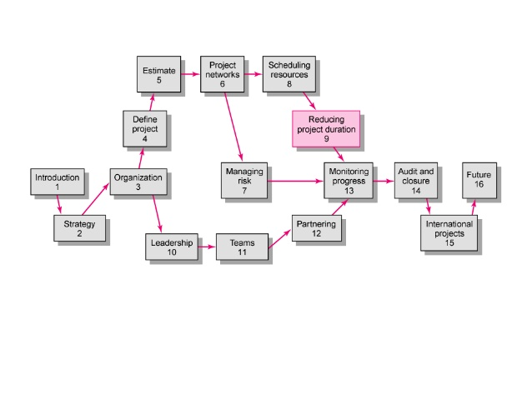

Slide 4
contents
Introduction
Rationale for Reducing Project Duration
Options for Accelerating Project Completion
Project Cost–Duration Graph
Constructing a Project Cost–Duration Graph
Practical Considerations
What if Cost, Not Time, Is the Issue?
Summary

Slide 5
What do you do?
This chapter addresses strategies for reducing project duration either prior to setting the baseline for the project or in the midst of project execution. Choice of options is based on the constraints surrounding the project.
Here the project priority matrix introduced in Chapter 4 comes into play.

Slide 6
Rationale for reducing project duration
Time Is Money: Cost-Time Tradeoffs
Reducing the time of a critical activity usually incurs additional direct costs.
Cost-time solutions focus on reducing (crashing) activities on the critical path to shorten overall duration of the project.
Reasons for imposed project duration dates:
Customer requirements and contract commitments
Time-to-market pressures
Incentive contracts (bonuses for early completion)
Unforeseen delays
Overhead and goodwill costs
Pressure to move resources to other projects

Slide 7
Why reduce project duration:
There is a need to complete the project before plan date to responded customer demand.
In recent years emphasis on time to market has taken new importance because of intense global competition and rapid technological advances.
Reduce project duration so as to minimize risk caused by unforeseen delays for example adverse weather, design flaws and equipment breakdown.
There are time for reassigning key equipment and/or people to new project. Under these circumstances the cos of compressing the project can be compared with the cost of not releasing key equipment or people.

Slide 9
Options for Accelerating Project Completion
Managers have several effective methods for crashing specific project activities when resources are not constrained. Several of these are summarized below.
Adding Resources resources are typically people included in your project plans weather or not they are assigned to task. The resources could also include anything that is use to complete a project including equipment and other material, such as material, cement and webserver.
Outsourcing Project Work outsourcing is a business practices in which a company hires another company or an indidual to perform task handle operations or provide services that are either usually executed or had previously being done by the companies own employees

Slide 10
Options for Accelerating Project Completion
Scheduling Overtime scheduling over time is a challenging task for employers. We often think of overtime as an opportunity for employees to earn more money.
Establish a Core Project Team a team is defined as an interdependent collection of individulas who work together towards a common goal and who share responsibilities for specific outcomes of their organizations.
Do It Twice—Fast and Correctly if you are in hurry try building a quick and dirty short term solutions then go back and do it in a right way

Slide 11
Options When Resources Are Constrained
Fast-Tracking: fast tracking is a technique where activities that would have been performed sequentially using the original schedule are performed in parallel.
Reducing Project Scope: Probably the most common response for meeting unattainable deadlines is to reduce or scale back the scope of the project.
Compromise Quality: Reducing quality is always an option, but it is rarely acceptable or used. If quality is sacrificed, it may be possible to reduce the time of an activity on the critical path.

Slide 13
Project Cost–Duration Graph
This section describes a procedure for identifying the costs of reducing project time so that comparisons can be made with the benefits of getting the project completed sooner.
The method requires gathering direct and indirect costs for specific project durations.
Critical activities are searched to find the lowest direct-cost activities that will shorten the project duration.
Total cost for specific project durations are computed and then compared with the benefits of reducing project time.

Slide 14
Explanation of Project Costs
Project Indirect Costs: Indirect costs generally represent overhead costs such as supervision, administration, consultants, and interest.
Indirect costs cannot be associated with any particular work package or activity, hence the term.
Indirect costs vary directly with time.
Project Direct Costs: Direct costs commonly represent labor, materials, equipment, and sometimes subcontractors.
Direct costs are assigned directly to a work package and activity, hence the term.
Crashing activities increases direct costs.

Slide 15
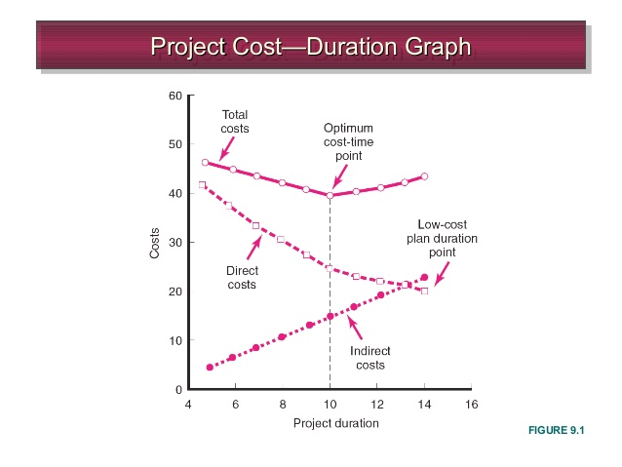
Project Cost–Duration Graph

Slide 16
Difference b/w Total & Free slack
Total Slack
The amount of time an activity can be delayed without delaying the entire project
Total slack =ES – LS
Free Slack (or Float)
The amount of time an activity can be delayed without delaying connected successor activities
Tends to happen as the last activity in a path before a merge activity (when another path is the critical one)
.

Slide 17
Constructing a Project Cost–Duration Graph
There are three major steps required to construct a project cost–duration graph:
1. Find total direct costs for selected project durations.
2. Find total indirect costs for selected project durations.
3. Sum direct and indirect costs for these selected durations.

Slide 18
Constructing a Project Cost–Duration Graph
Terms to know
Normal time: for an activity represents low-cost, realistic, efficient methods for completing the activity under normal conditions.
Crashing: Shortening an activity
crash time: The shortest possible time an activity can realistically be completed in.
crash point: the maximum time an activity can be compressed.
Slope: The heavy line connecting the normal and crash points.

Slide 19
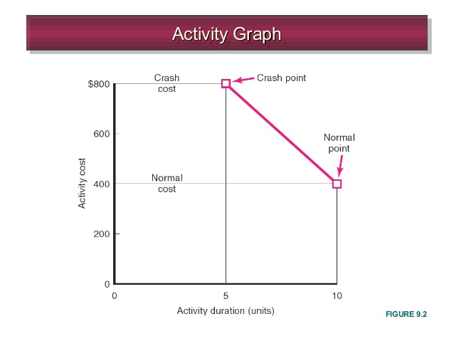
Activity Graph

Slide 20
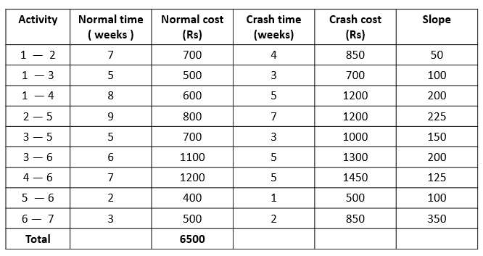
Example, crash time:

Slide 21
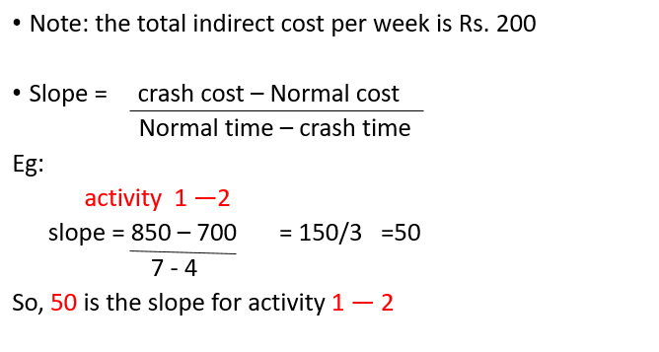
How to find slope:

Slide 22
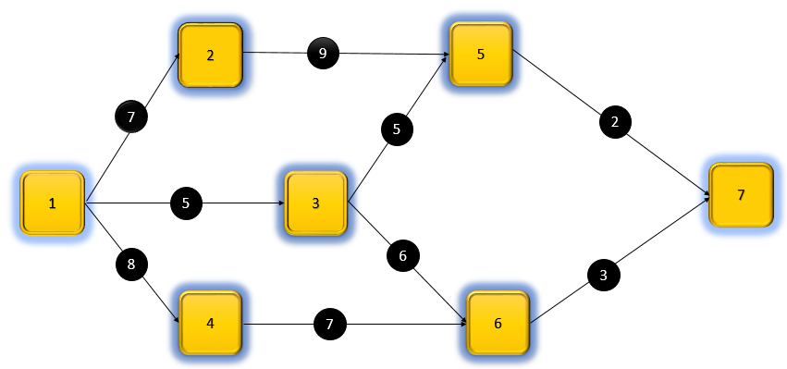
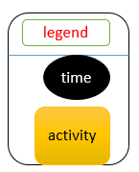
Selection of critical path:

Slide 23
Cont.…
The maximum completion time is called critical path.
1—2—5—7 = 7+9+2 = critical path
1—3—5—7 = 5+5+2 = 12
1—3—6—7 = 5 +6+3 = 14
1—4—6—7 = 8+7+3 = critical path
18
18

Slide 24
Normal project completion time:
Normal project completion time = 18 weeks.
Critical paths are,
1—2—5—7
&
1—4—6—7
The total direct cost = 6,500
Indirect cost (200*18) = 3600

Slide 25
Total cost:
Total cost = direct cost + indirect cost
Total cost = 6500 + 3600
Total cost = 10,100

Slide 26
Critical path | Critical activity | Crash limit | cost slope
1—2—5—7 | 1—2 | 3 | 50
 | 2—5 | 2 | 225
 | 5—7 | 1 | 100
1—4—6—7 | 1—4 | 3 | 200
 | 4—6 | 2 | 125
 | 6—7 | 1 | 350

Slide 27
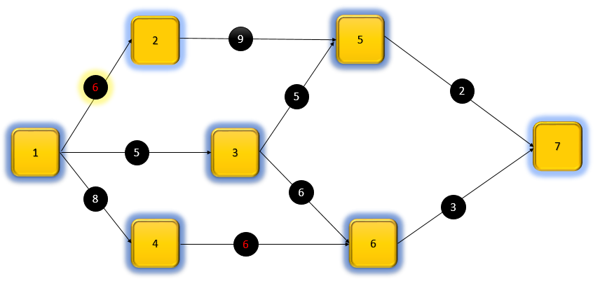
Cont..

Slide 28
cont.…
The maximum completion time is called critical path.
1—2—5—7 = 6+9+2 = critical path
1—3—5—7 = 5+5+2 = 12
1—3—6—7 = 5 +6+3 = 14
1—4—6—7 = 8+6+3 = critical path
17
17

Slide 29
Crashing one week
Project completion time after crashing is 17 weeks.
After reducing one week the direct expanse increase and indirect expanse decrease.
Reducing time is directly proportion to indirect expanse & inversely proportion to direct cost.
This shows that the total cost is changed when the time is reduced.

Slide 30
Total cost:
Total cost = previous total cost + direct expense - indirect expense
Total cost after crashing one week
=10,100 + (50+125) – 200
= 10,075

Slide 31
Critical path | Critical activity | Crash limit | cost slope
1—2—5—7 | 1—2 | 2 | 50
 | 2—5 | 2 | 225
 | 5—7 | 1 | 100
1—4—6—7 | 1—4 | 3 | 200
 | 4—6 | 1 | 125
 | 6—7 | 1 | 350

Slide 32
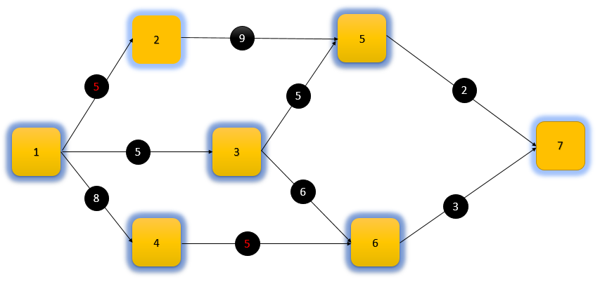
Cont. ..

Slide 33
Cont. ..
The maximum completion time is called critical path.
1—2—5—7 = 5+9+2 = critical path
1—3—5—7 = 5+5+2 = 12
1—3—6—7 = 5 +6+3 = 14
1—4—6—7 = 8+5+3 = critical path
16
16

Slide 34
Total cost:
Project completion time after crashing is 16 weeks
Total cost = previous total cost + direct expense - indirect expense
Total cost after crashing one week (total crashing two weeks)
=10,075 + (50+125) – 200
= 10,050

Slide 35
Critical path | Critical activity | Crash limit | cost slope
1—2—5—7 | 1—2 | 1 | 50
 | 2—5 | 2 | 225
 | 5—7 | 1 | 100
1—4—6—7 | 1—4 | 3 | 200
 | 4—6 | 0 | 125
 | 6—7 | 1 | 350

Slide 36
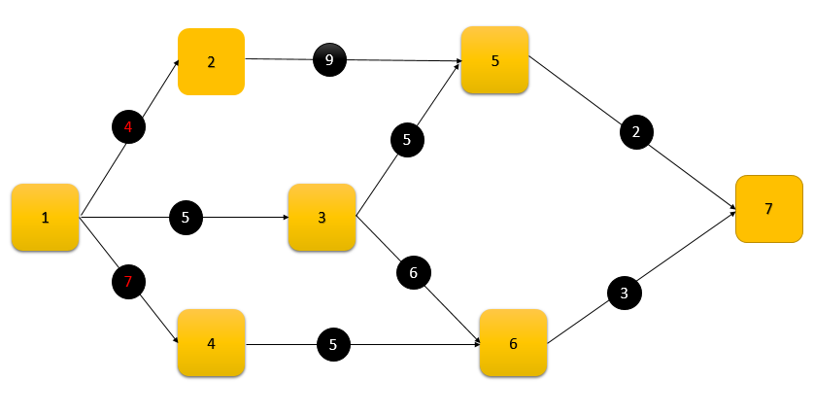
Cont. ..

Slide 37
Cont. ..
The maximum completion time is called critical path.
1—2—5—7 = 4+9+2 = critical path
1—3—5—7 = 5+5+2 = 12
1—3—6—7 = 5 +6+3 = 14
1—4—6—7 = 7+5+3 = critical path
15
15

Slide 38
Cont. ..
Project completion time after crashing is 15 weeks.
Total cost = previous total cost + direct expense - indirect expense
Total cost after crashing one week (total crashing two weeks)
=10,50 + (50+200) – 200
= 10,100

Slide 39
Final result:
Since the total cost of this iteration is more than that of the previous iteration so stop the procedure and treat the solution previous iteration as the best solution for implementation. The final crashed project completion time is 16 weeks corresponding critical paths are,
1-2-5-7
&
1-4-6-7.
4
3

Slide 40
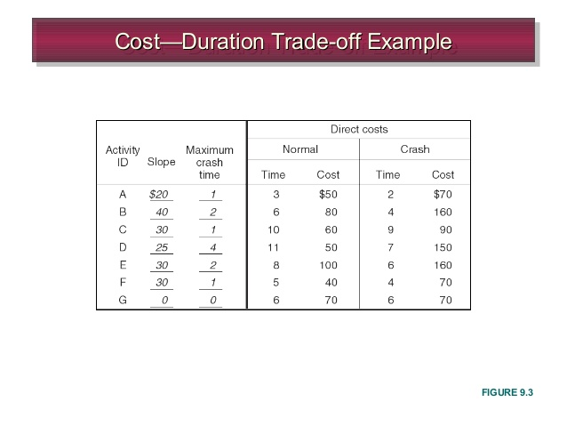
Cost–Duration Trade-off Example

Slide 41
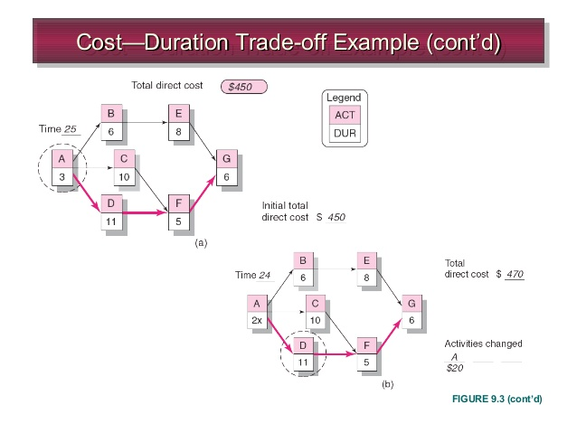
Cost–Duration Trade-off Example cont..

Slide 42
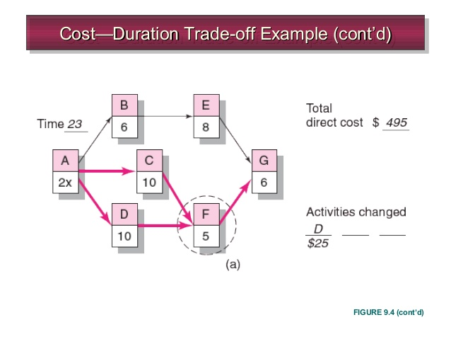
Cont..

Slide 43
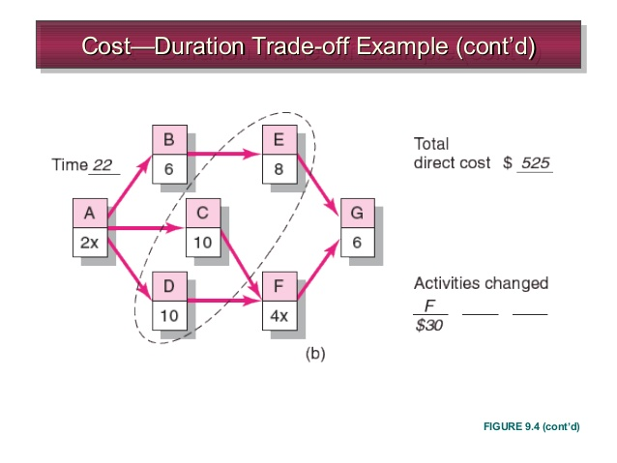
Cont..

Slide 44
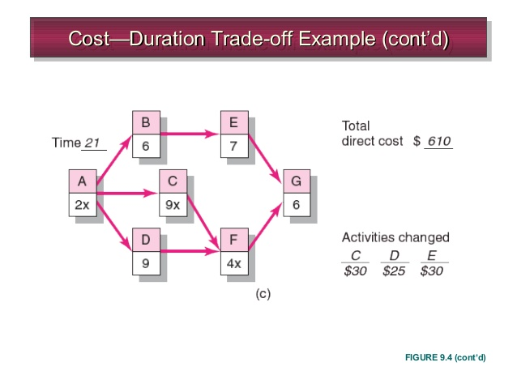
Cont.…

Slide 45
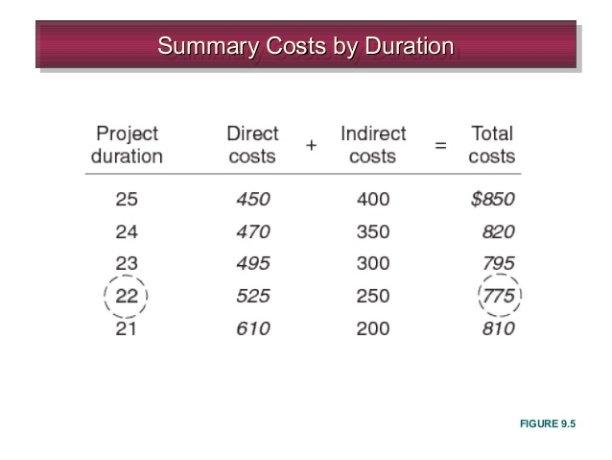
Summary costs by duration

Slide 46
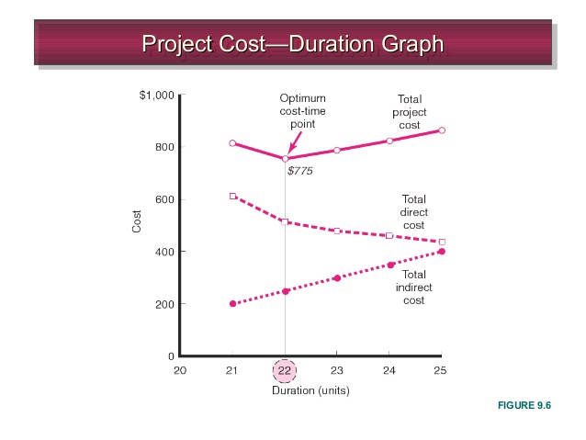
Project cost-duration graph

Slide 47
Practical considerations
Using the Project Cost—Duration Graph
Crash Times
Linearity Assumption
Choice of Activities to Crash Revisited
Time Reduction Decisions and Sensitivity

Slide 48
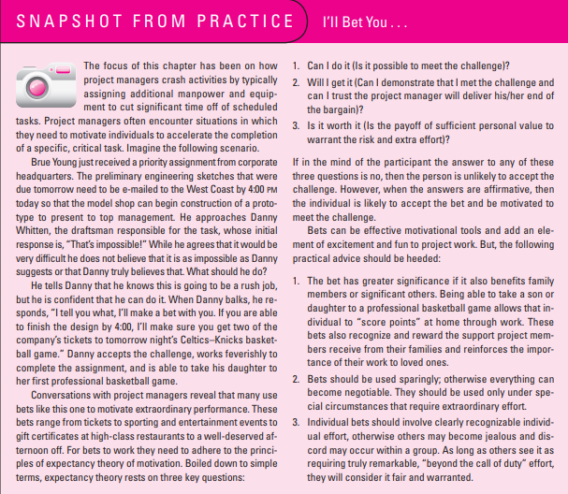

Slide 49
What if Cost, Not Time, Is the Issue?
In today’s fast-paced world, there appears to be a greater emphasis on getting things done quickly. Still, organizations are always looking for ways to get things done cheaply.
This is especially true for fixed-bid projects, where profit margin is derived from the difference between the bid and actual cost of the project. e always looking for ways to get things done cheaply.
As discussed earlier, shortening project duration may come at the expense of overtime, adding additional personnel, and using more expensive equipment and/ or materials. Conversely, sometimes cost savings can be generated by extending the duration of a project. This may allow for a smaller workforce, less-skilled (expensive) labor, and even cheaper equipment and materials to be used.

Slide 50
Some of the more commonly used options for cutting costs
Reduce project scope
Have owner take on more responsibility
Outsourcing project activities or even the entire project
Brainstorming cost savings options

Slide 51
Reduce project scope
Project scope is the part of project planning that involves determining and documenting a list of specific project goals, deliverables, features, functions, tasks, deadlines, and ultimately costs
In other words, it is what needs to be achieved and the work that must be done to deliver a project
However, since time is not the issue, you do not need to focus on critical activities
For example, on over-budget movie projects it is not uncommon to replace location shots with stock footage to cut costs

Slide 52
Have owner take on more responsibility
One way of reducing project costs is identifying tasks that customers can do themselves
An advantage of this method is that, while costs are lowered, the original scope is retained
Homeowners frequently use this method to reduce costs on home improvement projects
For example
to reduce the cost of a room remodel, a homeowner may agree to paint the room instead of paying the contractor to do it

Slide 53
Outsourcing project activities or even the entire project
When estimates exceed budget, it not only makes sense to re-examine the scope but also search for cheaper ways to complete the project
Perhaps instead of relying on internal resources, it would be more cost effective to outsource segments or even the entire project, opening up work to external price competition
Example
to reduce costs of software projects, many American firms outsource work to firms operating in India where the salary of a software engineer is one-third that of an American software engineer

Slide 54
Brainstorming cost savings options
Brainstorming is a group of activity by which efforts are made to find a conclusion for a specific problem by gathering a list of ideas spontaneously contributed by its members.
Project team members can be a rich source of ideas for accelerating project activities

Slide 55
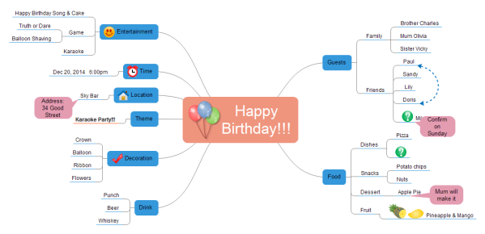

Slide 56
Summary
The need for reducing the project duration occurs for many reasons such as imposed duration dates, time-to-market considerations, or simply unforeseen delays
This chapter presented a logical, formal process for assessing the implications of situations that involve shortening the project duration
How far to reduce the project duration from the normal time toward the optimum depends on the sensitivity of the project network
A sensitive network is one that has several critical or near-critical paths

Slide 57
Cont’’’
Alternative strategies for reducing project time were discussed within the context of whether or not the project is resource limited
Project acceleration typically comes at a cost of either spending money for more resources or compromising the scope of the project
A sensitive network is one that has several critical or near-critical paths. Great care should be taken when shortening sensitive networks to avoid increasing project risks.

Slide 58


